Slide 1

Stock Price Forecasting in Presence of Covid-19 Pandemic with Machine Learning models.
Navid Mottaghi

Slide 2



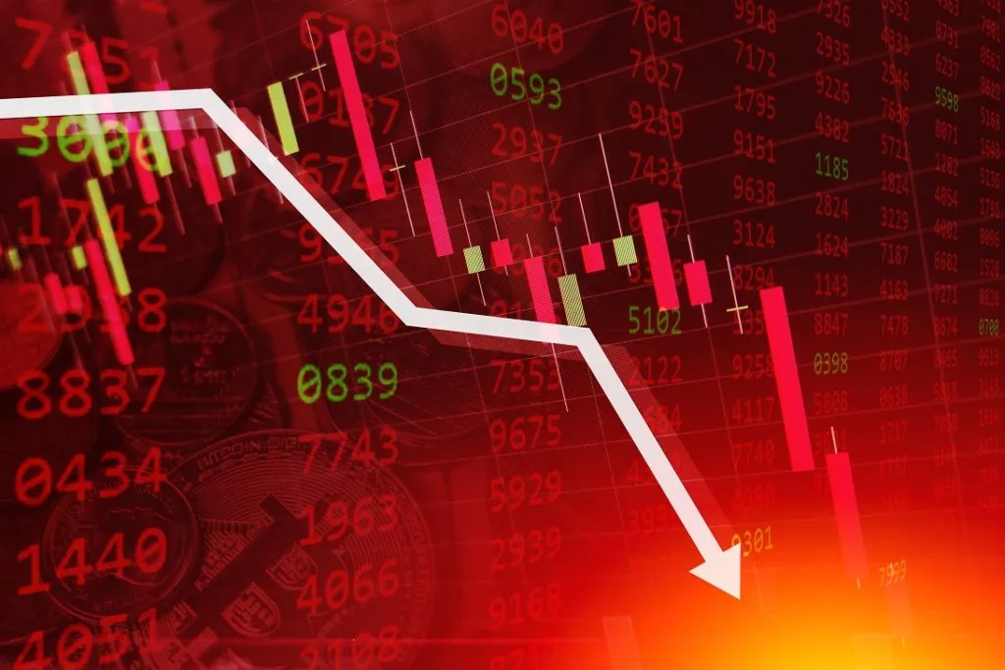


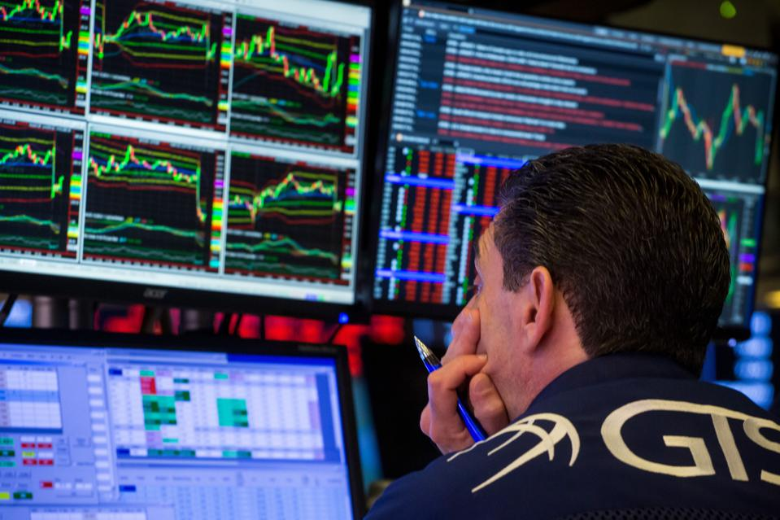


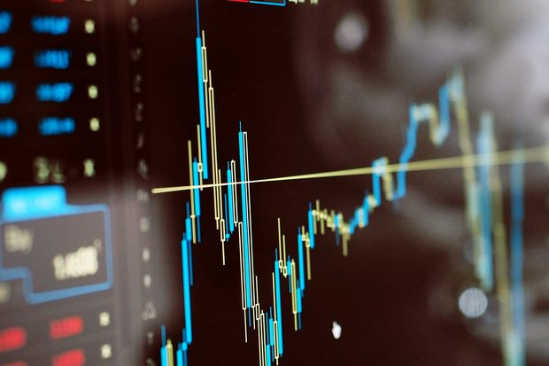
Stock selection
Covid-19
Stock Market

Slide 3
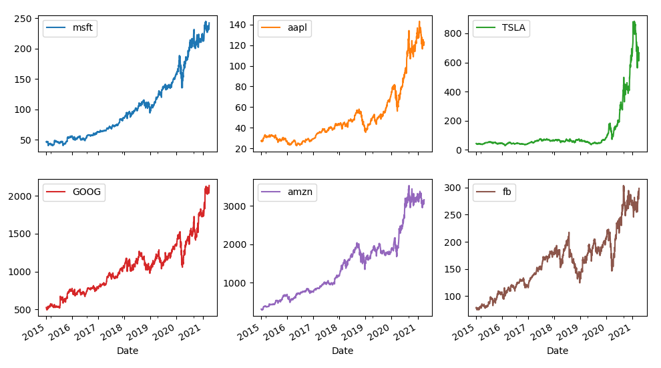
Stock prices: train (80%) and test (20%) data source: yahoo finance

Slide 4
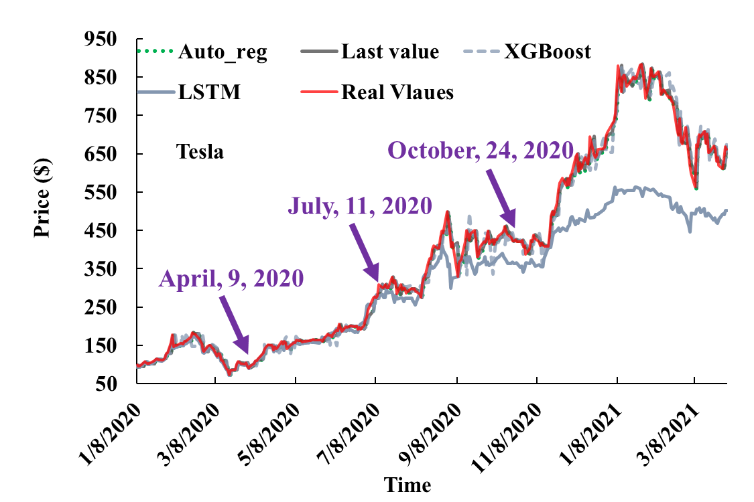
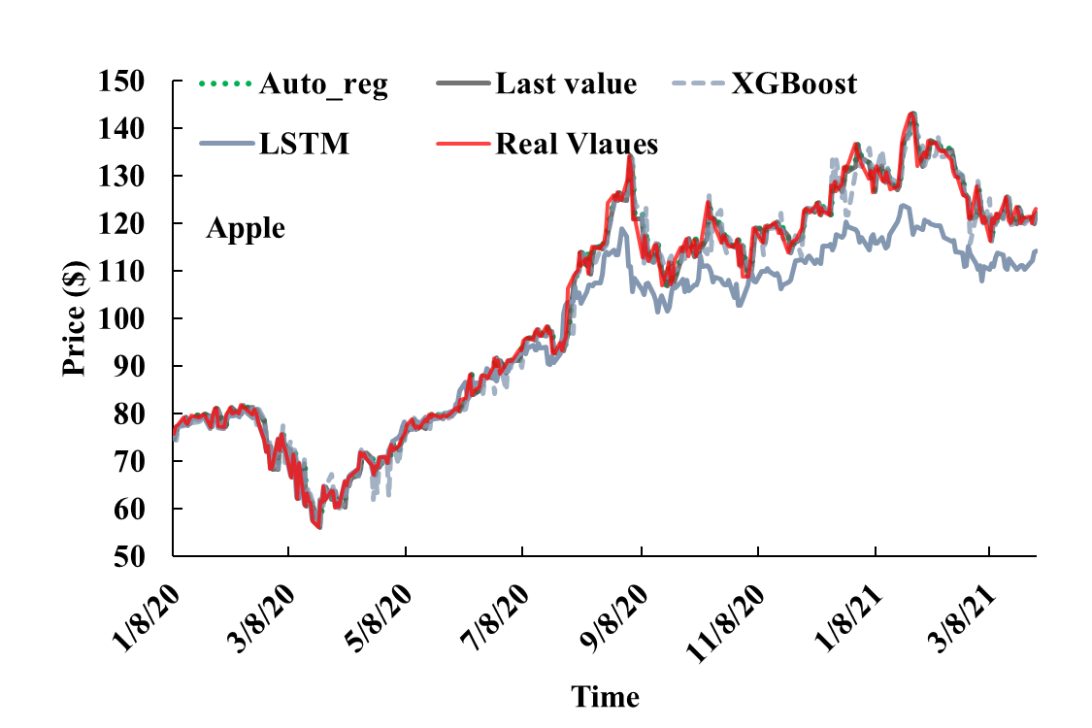
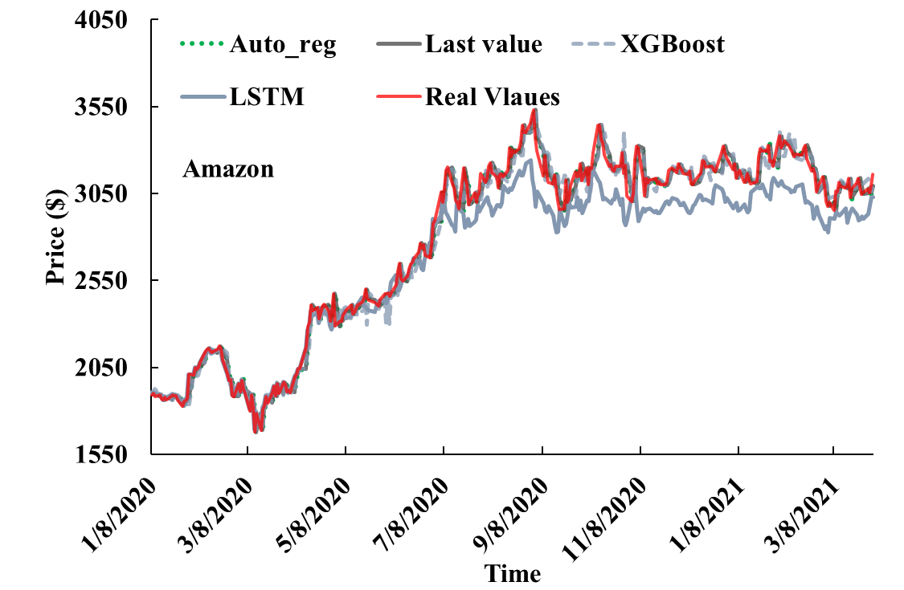
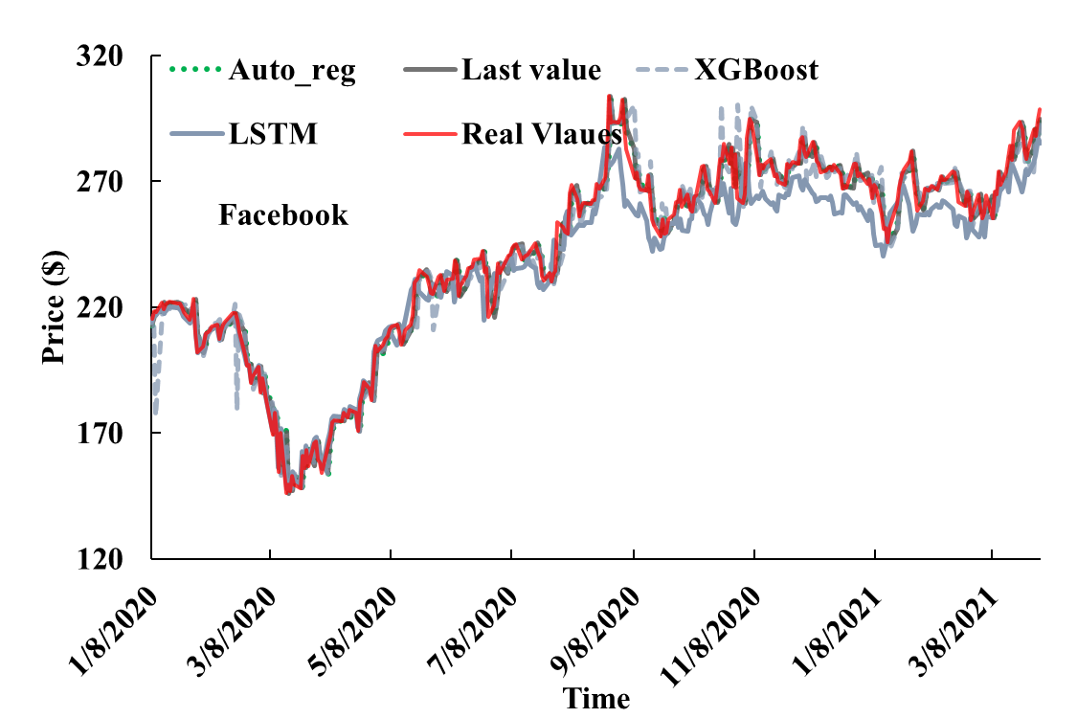
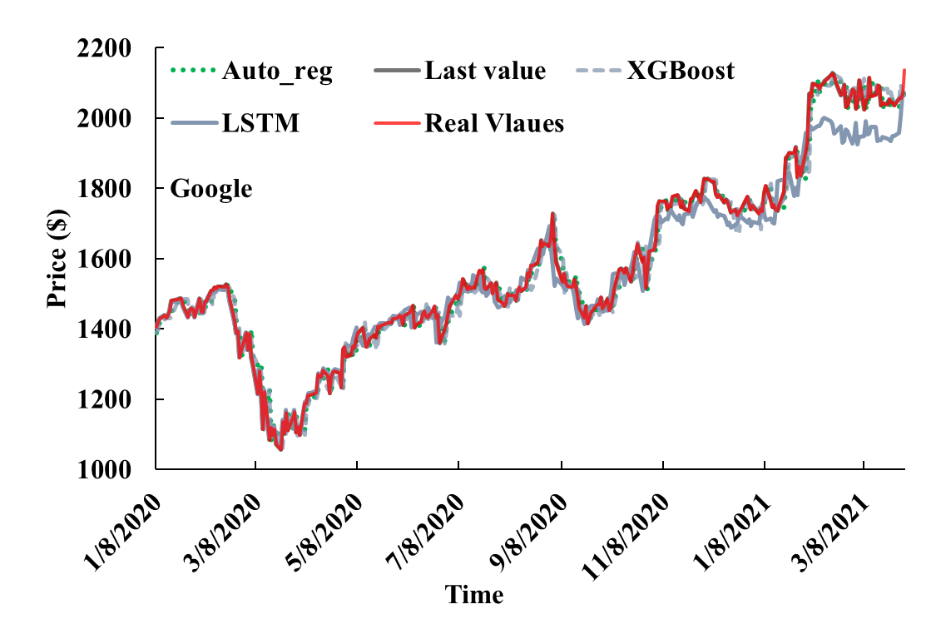
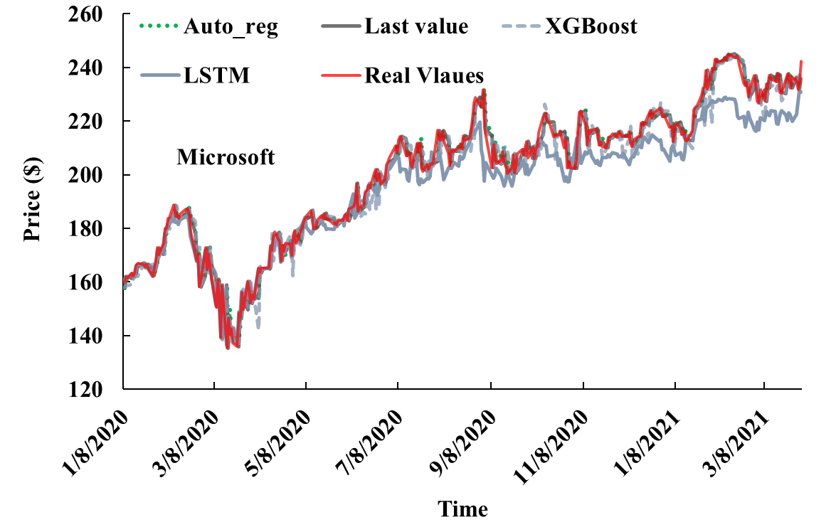
Fit the stock prices to Models: lstm, xgBoost, auto-regression, and last value

Slide 5
Auto-regression and last value have better performances

Slide 6
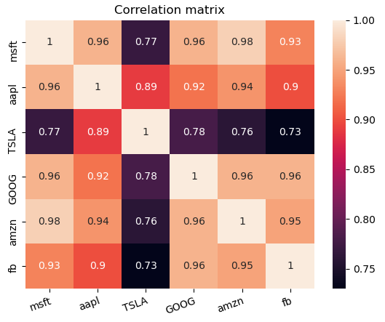
Stock selection
Each stock price can be used as a feature in the model to predict the other stock price

Slide 7

Thank you ☺

Slide 8
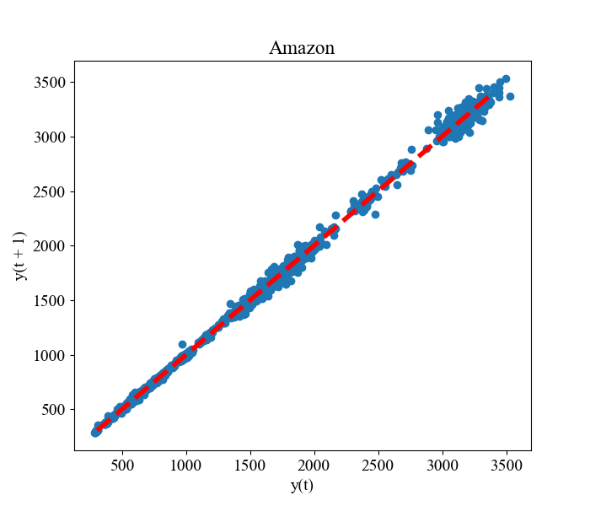
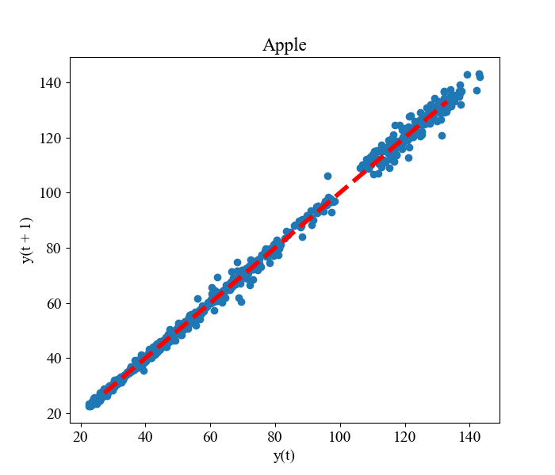
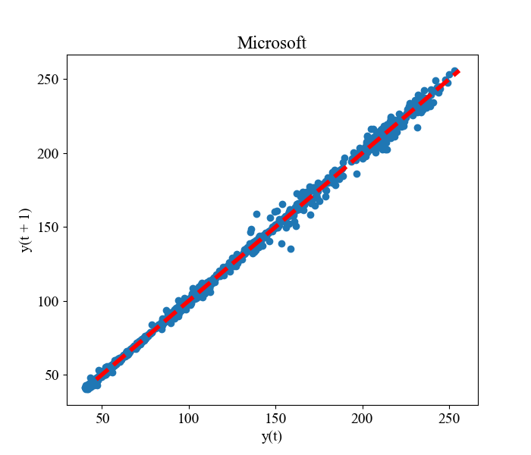
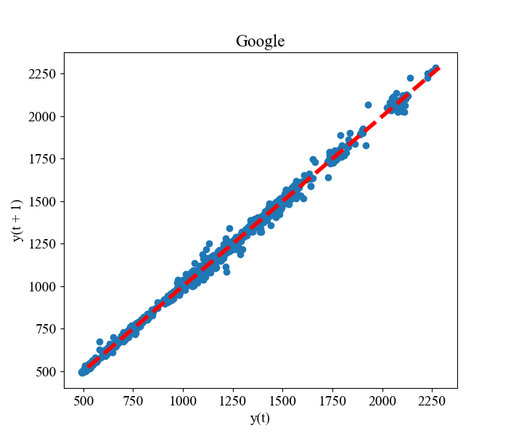
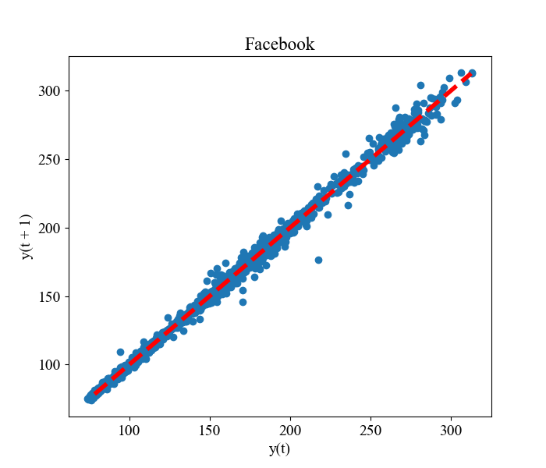
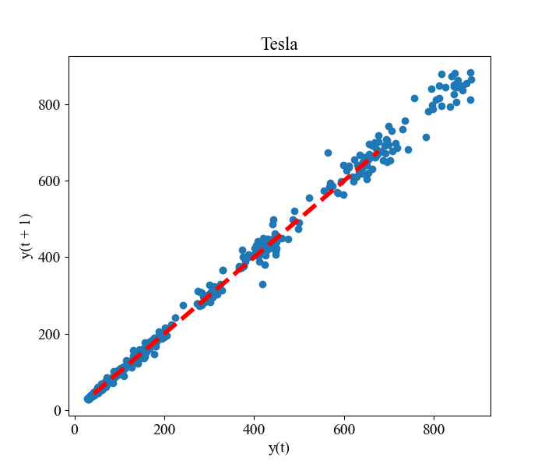
Lag plots

Slide 9
Summary statistics of data
 | Mean | Min | Max | SD | No. Obs
Microsoft Training Set Test Set | 81.31 202.06 | 40.29 135.41 | 160.62 255.85 | 32.29 26.42 | 1262 316
Apple Training Set Test Set | 38.73 102.59 | 22.58 56.09 | 75.08 143.16 | 11.19 23.71 | 1262 316
Tesla Training Set Test Set | 53.89 389.33 | 28.73 72.24 | 93.81 833.09 | 11.39 241.76 | 1262 316
Google Training Set Test Set | 915.09 1593.99 | 491.20 1056.62 | 1394.21 2285.88 | 232.13 273.57 | 1262 316
Amazon Training Set Test Set | 1117.52 2796.26 | 286.95 1676.61 | 2039.51 3531.45 | 535.89 521.74 | 1262 316
Facebook Training Set Test Set | 143.28 242.95 | 74.05 146.01 | 217.5 313.09 | 38.21 38.39 | 1262 316

